Slide 1
High-resolution spectrogram
Yi-Hao Chen
6/14/2021

Slide 2
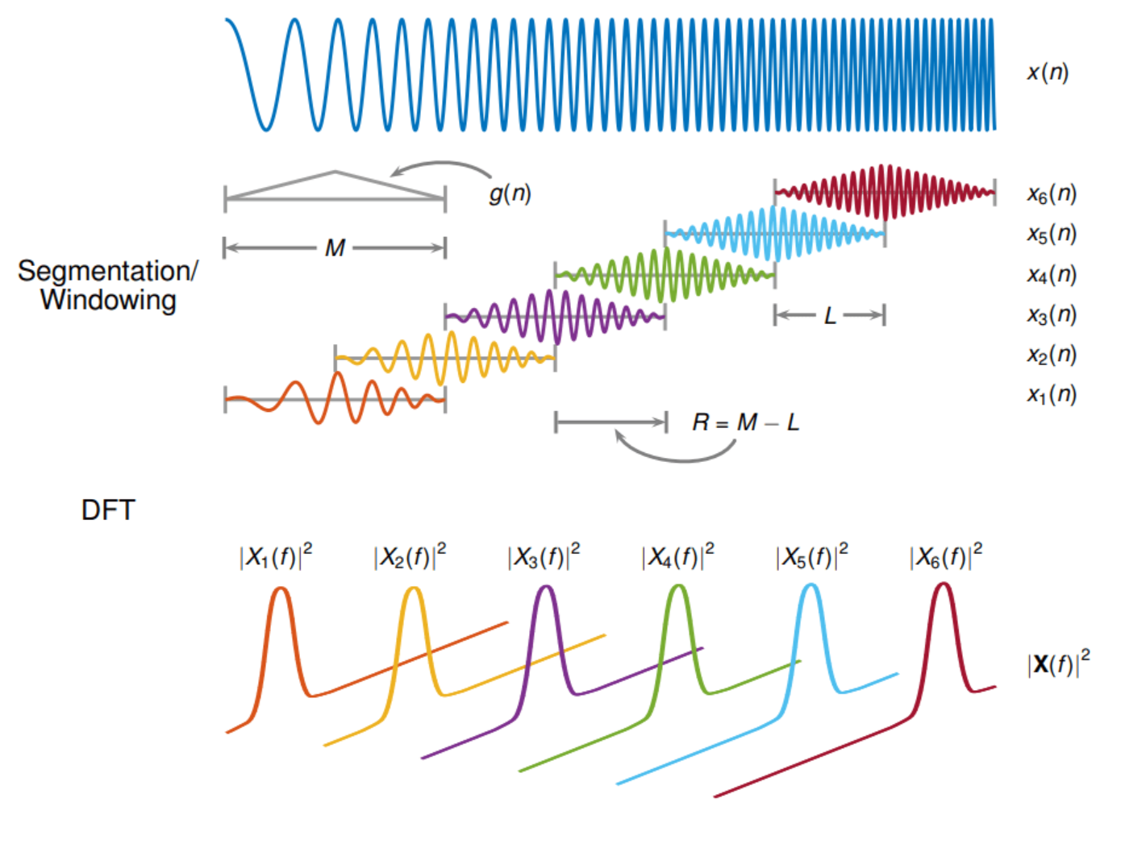
Short-time Fourier Transform
Sliding time window finds the spectrum for each temporal slice.
https://www.mathworks.com/help/signal/ref/stft.html

Slide 3
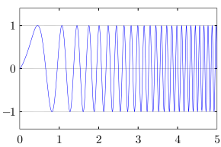
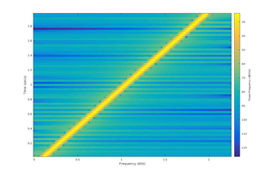
Example: Spectrogram of a chirped signal
Signal intensity
Frequency (kHz)
Time (s)
https://en.wikipedia.org/wiki/Chirp

Slide 4
Tradeoff in obtaining a spectrogram
Small sliding time window
Good temporal resolution
Bad spectral resolution
Large sliding time window
Bad temporal resolution
Good spectral resolution
Solution:
Compute spectrograms of different window sizes
Idea:
If it’s a point (t,f) where there should be signal, there is always intensity under different window sizes
If it’s a point (t,f) where there shouldn’t be signal but there is intensity under certain window sizes, it’s from the spreading due to low resolution.
Final spectrogram = Max(spectrograms)*Min(spectrograms)
Khan, N. A.; Jafri, M. N. & Qazi, S. A., "Improved resolution short time Fourier transform", 7th International Conference on Emerging Technologies, 1-3 (2011)

Slide 5
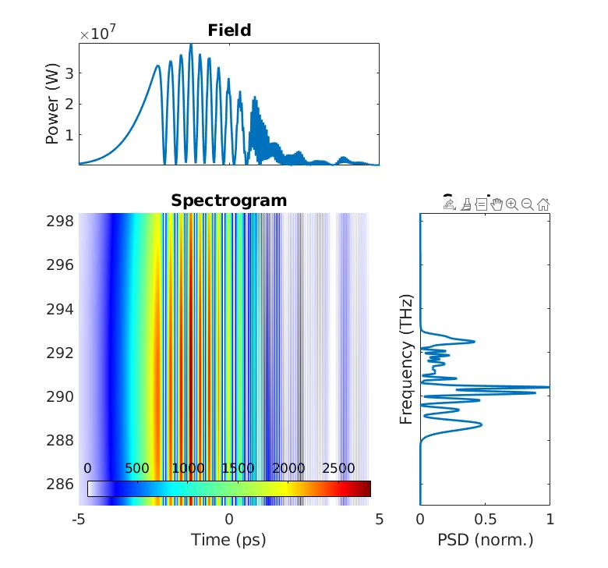
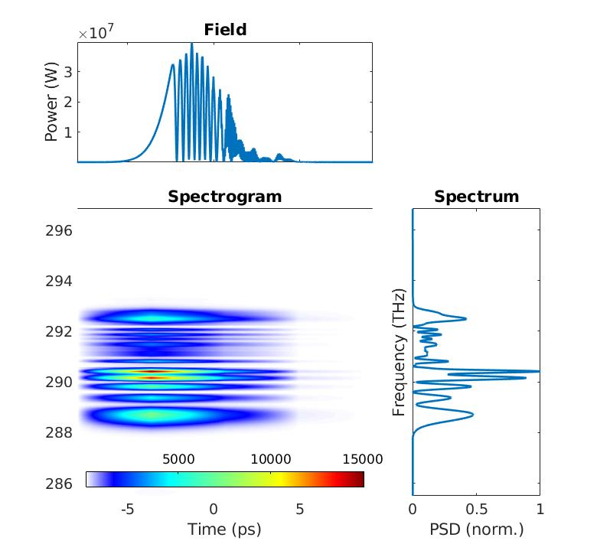
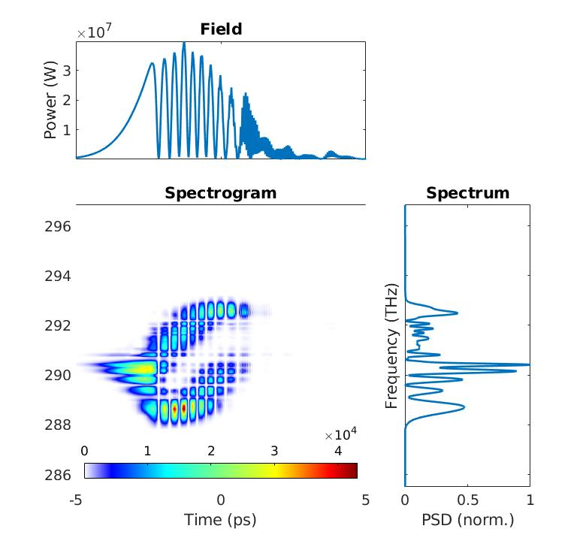
Take the example from my Raman simulation
Small sliding window
Large sliding window
Multiresolution spectrogram

Slide 6
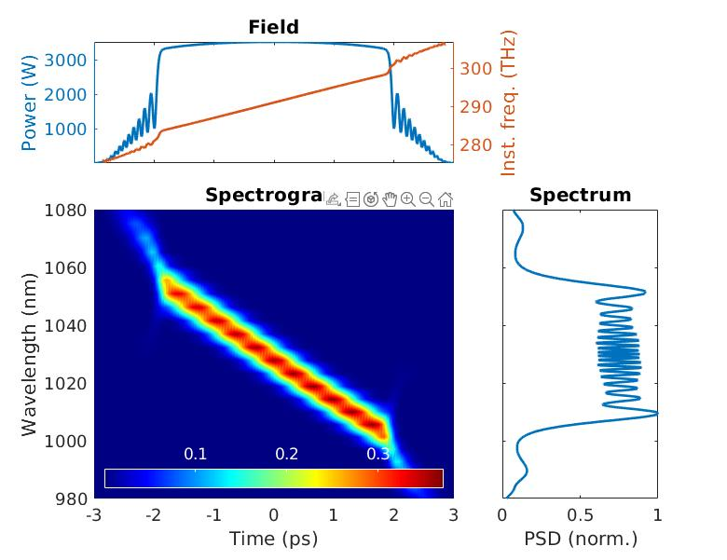
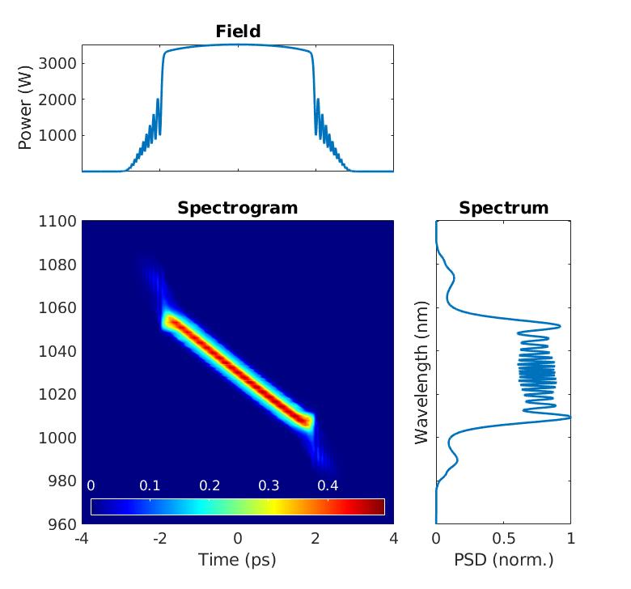
Wave-breaking
Typical short-time Fourier Transform
My code
It can’t capture the modulations well.

Slide 7
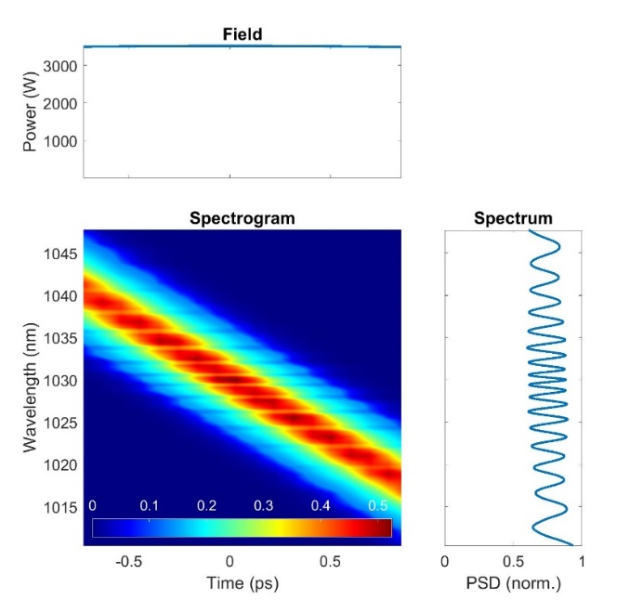
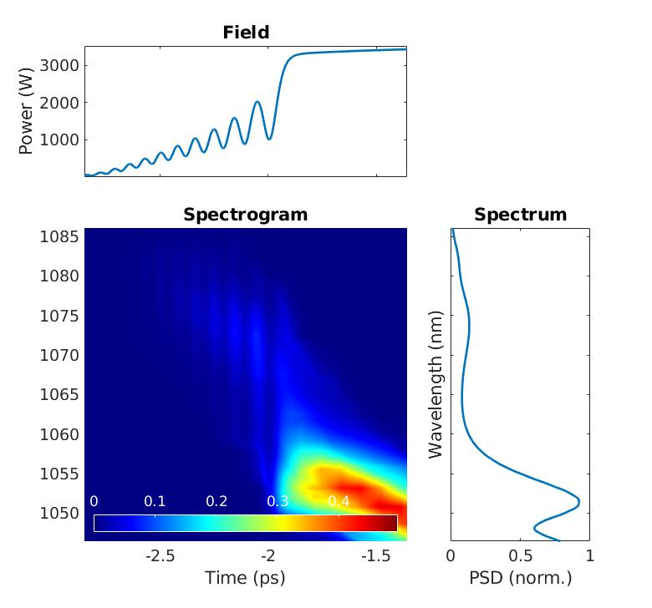
Wave-breaking: detailed look (from my code)
My code
Fast modulations in both the time and frequency are captured.

